Slide 1
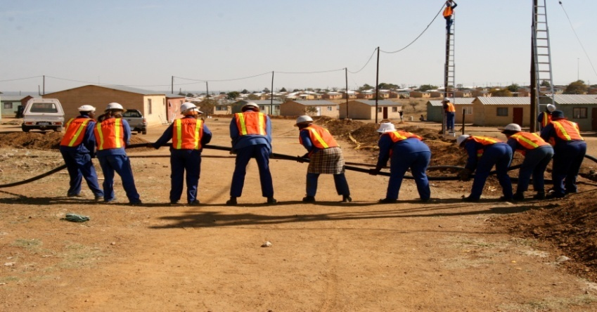
Expanded Public Works Programme EPWP 3rd Summit Commissions Discussions Template

Slide 2
Definition of Convergence in EPWP
Definition:
Convergence is the fostering of synergies within and amongst sectors and programmes of the Expanded Public Works Programme (EPWP) to ensure that resources are efficiently and effectively utilised to maximise benefits for sectors, programmes, and participants.
2

Slide 3
Commission 03: Practical measures to achieve convergence
Issue | Action | Responsibility | Time Frames
How should the EPWP sectors and programmes converge? | Development of the data base of programmes/projects between different spheres of government Identify projects/ program that have potential for convergence Development of Integrated planning to achieve the common objectives | Implementing public bodies | Ongoing

Slide 4
Commission 03: Practical measures to achieve convergence
Issue | Action | Responsibility | Time Frames
How should the EPWP sectors and programmes converge? | Use existing & proposed structures (NCC, PSC, PSSC, Sector committees, PPMT, District forums etc.) Reporting system to address the areas of convergence & improved validation of the reported projects | NDPW | 31 March 2015

Slide 5
Commission 03: Practical measures to achieve convergence
Issue | Action | Responsibility | Time Frames
At which stage of the project management cycle (i.e. conceptual, design, planning, implementation) should convergence take place and how? | Joint Conceptualisation of new project/programmes Identification of opportunities for convergence on the existing projects at any stage Phased in approach implementation of convergence. | Public bodies (IMC, IDP, PSC) | 31 March 2015

Slide 6
Commission 03: Practical measures to achieve convergence
Issue | Action | Responsibility | Time Frames
What is the role of the EPWP unit at DPW in terms of convergence? | Development & approval of EPWP frame work/policy and communication strategy Review terms of reference for existing structures to incorporate convergence | NDPW to develop the framework (partnership support unit) Province to customize (for provincial implementation) | 31 March 2015

Slide 7
ISSUES OF CONCERN FOR CONVERGENCE
Existing grey areas between sectors
Standardization of stipends
Is there a need for sectors?
Pilot the initiative/ good practices of convergence
Record an upload good practices, norms and standards on the EPWP website
Revival of Knowledge Management in EPWP
Practical selection of beneficiary processes for convergence

